Slide 1

Programing Clinic
Vehicle management
reporting person：Duan Youzhen
reporting time：09.06.2024
Notes:
模板来自于： 第一PPT https://www.1ppt.com/

Slide 2
Project ideas
Basic event flow：
In order to optimise urban traffic, the department would like to analyse the flow of vehicles at different times of the day and identify areas prone to congestion. The system should provide insights to help manage and reduce traffic congestion.
Notes:
模板来自于： 第一PPT https://www.1ppt.com/

Slide 3
Project ideas
Suggested methodology：
You should enhance the existing system by.
Implementing a function to analyse the number of vehicles passing through a city intersection at different times of day
Identify areas prone to congestion based on traffic flow data.
Key point: consider using data visualisation tools to represent traffic flows and congestion patterns.In addition, implement algorithms to predict congestion times and suggest alternative routes to drivers via email when congestion is detected.
Notes:
模板来自于： 第一PPT https://www.1ppt.com/

Slide 4
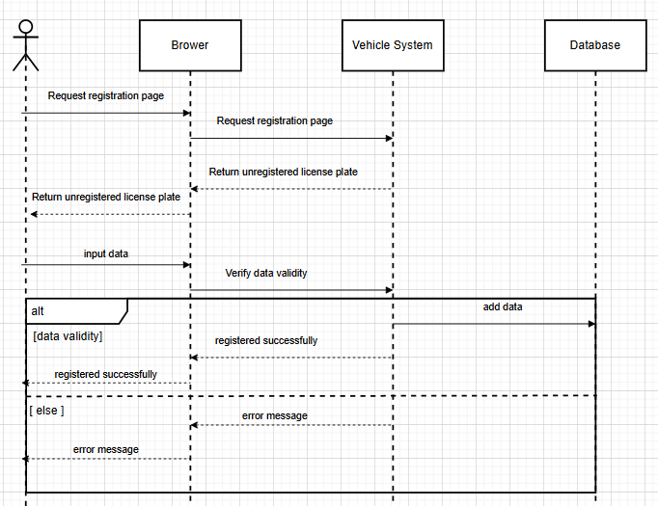
UML diagram-Vehicle Registration Timeline
Notes:
模板来自于： 第一PPT https://www.1ppt.com/

Slide 5
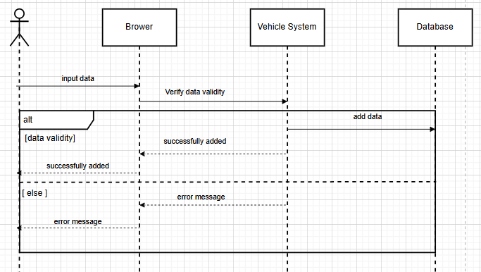
Record Information Sheet
Notes:
模板来自于： 第一PPT https://www.1ppt.com/

Slide 6
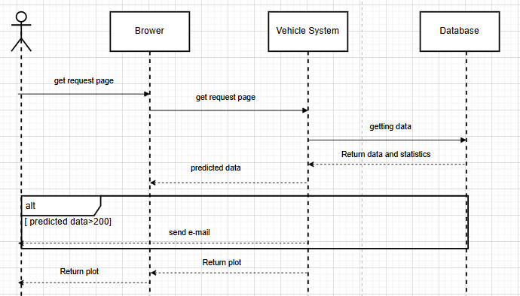
Traffic jam
Notes:
模板来自于： 第一PPT https://www.1ppt.com/

Slide 7
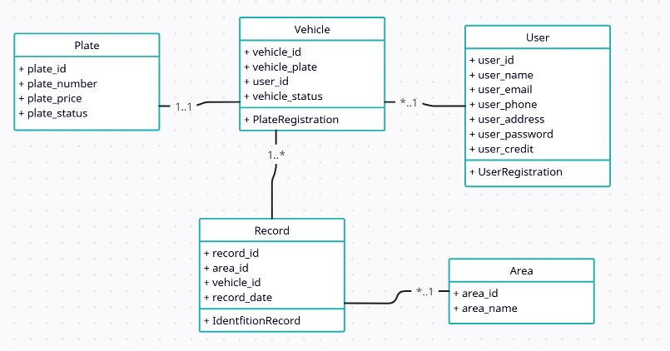
Class diagram
Notes:
模板来自于： 第一PPT https://www.1ppt.com/

Slide 8
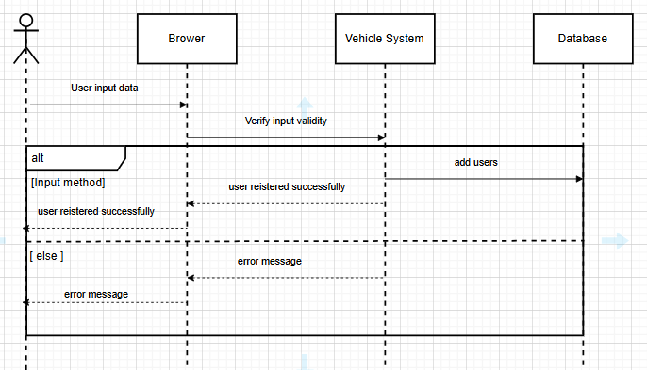
User Registration Timeline
Notes:
模板来自于： 第一PPT https://www.1ppt.com/

Slide 9
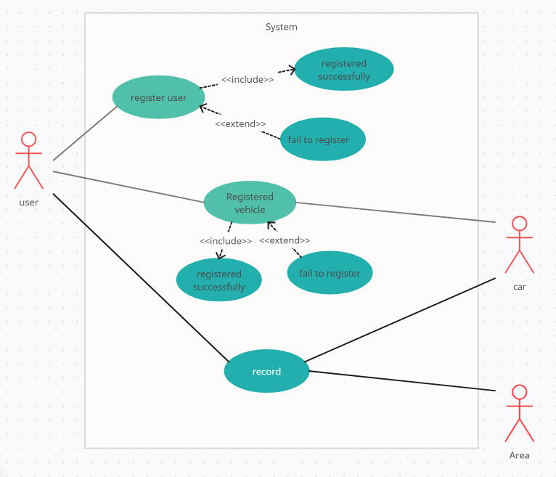
Use case diagram-1
Notes:
模板来自于： 第一PPT https://www.1ppt.com/

Slide 10
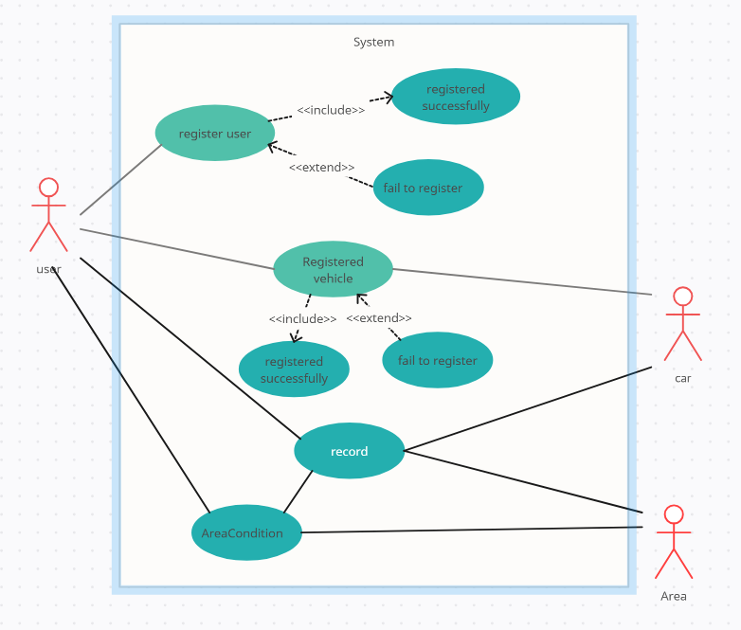
Use case diagram-2
Notes:
模板来自于： 第一PPT https://www.1ppt.com/

Slide 11
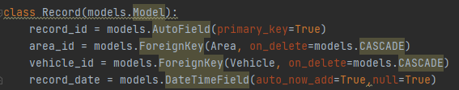
1. Modify the model of registered licence plate number
Add area_id class
Notes:
模板来自于： 第一PPT https://www.1ppt.com/

Slide 12

2.New regional models
Notes:
模板来自于： 第一PPT https://www.1ppt.com/

Slide 13
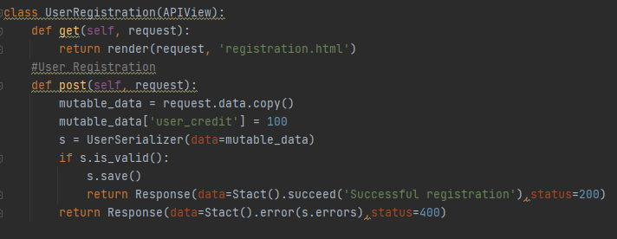
3. Add owner class
Notes:
模板来自于： 第一PPT https://www.1ppt.com/

Slide 14
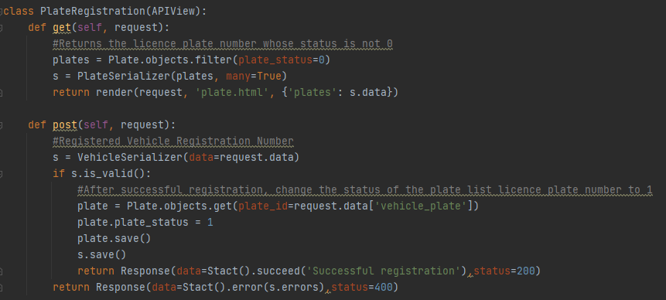
4. Registering a car registration number, entering
the owner's number and selecting a car registration number
Notes:
模板来自于： 第一PPT https://www.1ppt.com/

Slide 15
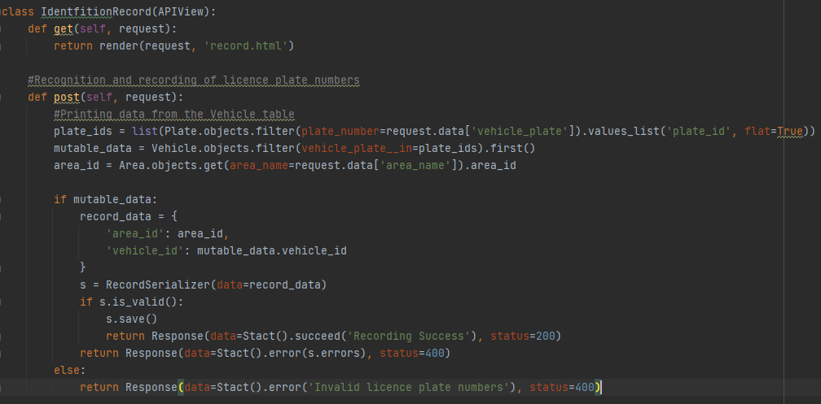
5. Record the licence plate number, record the owner
and licence plate number and the current time
Notes:
模板来自于： 第一PPT https://www.1ppt.com/

Slide 16
6. Count the number of times vehicles appear in each region
in the RECORD table, visualise it, and use the ARIMA model to
predict it, set the traffic flow per region not to be greater than 200,
otherwise, send an email notification to the user.
Notes:
模板来自于： 第一PPT https://www.1ppt.com/

Slide 17
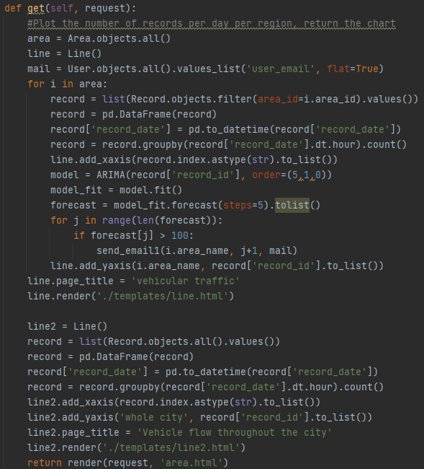
Notes:
模板来自于： 第一PPT https://www.1ppt.com/

Slide 18
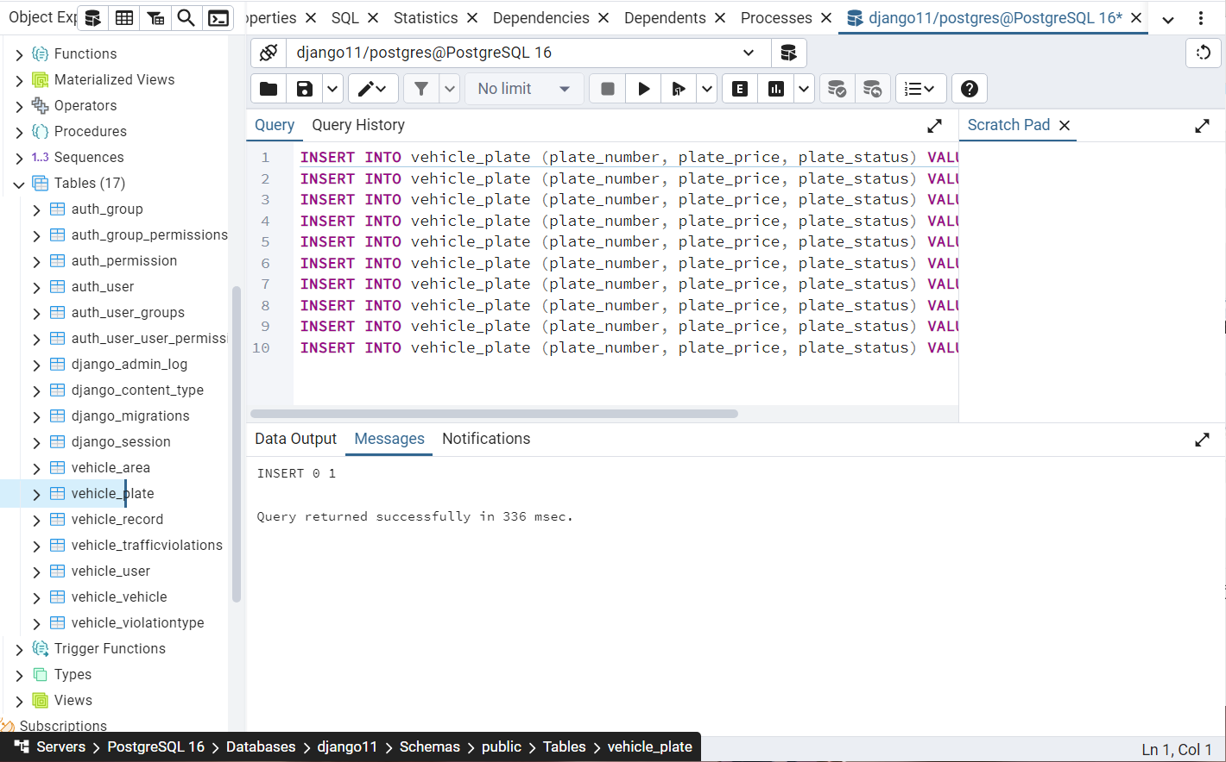
7. Simulating Data in PostgreSQL
Notes:
模板来自于： 第一PPT https://www.1ppt.com/

Slide 19
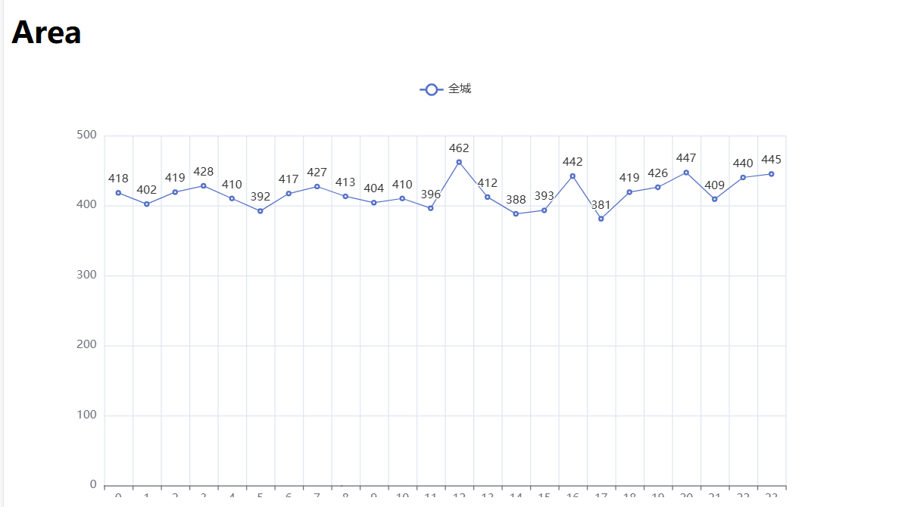
9.Traffic Statistics
-Get Request
Notes:
模板来自于： 第一PPT https://www.1ppt.com/

Slide 20
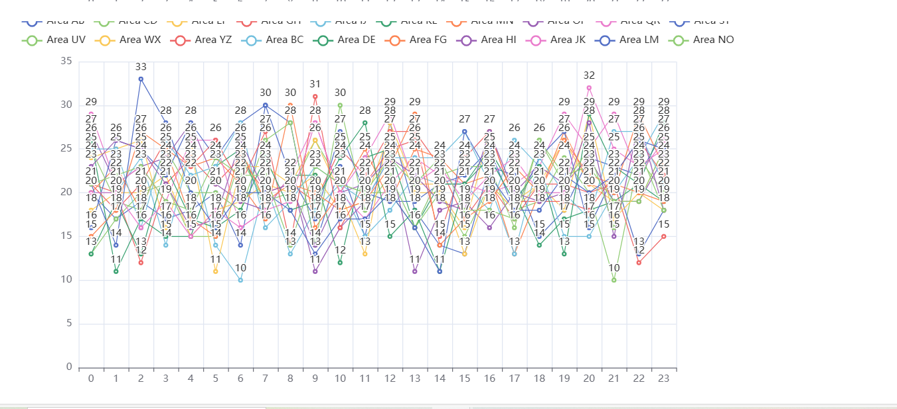
9.Traffic Statistics
-Get Request
Notes:
模板来自于： 第一PPT https://www.1ppt.com/

Slide 21
DEMO
Notes:
模板来自于： 第一PPT https://www.1ppt.com/

Slide 22
Thanks for watching.

